Slide 1

Session Name:
Group Decision-Making & Techniques
Delivered By:
Vikash Singh

Slide 2

Learning Objectives
By the end of this session, you will be able to:
Understand group decision-making
Apply quantitative and statistical models
Learn forecasting techniques

Slide 3














Introduction to Group Decision-Making
A process where two or more people collectively make a choice.
Common in businesses for complex, strategic decisions.

Slide 4



Advantages of Group Decision-Making

Slide 5





Disadvantages of Group Decision-Making
Time-consuming
Groupism risk
Dominance issues
Accountability problems

Slide 6
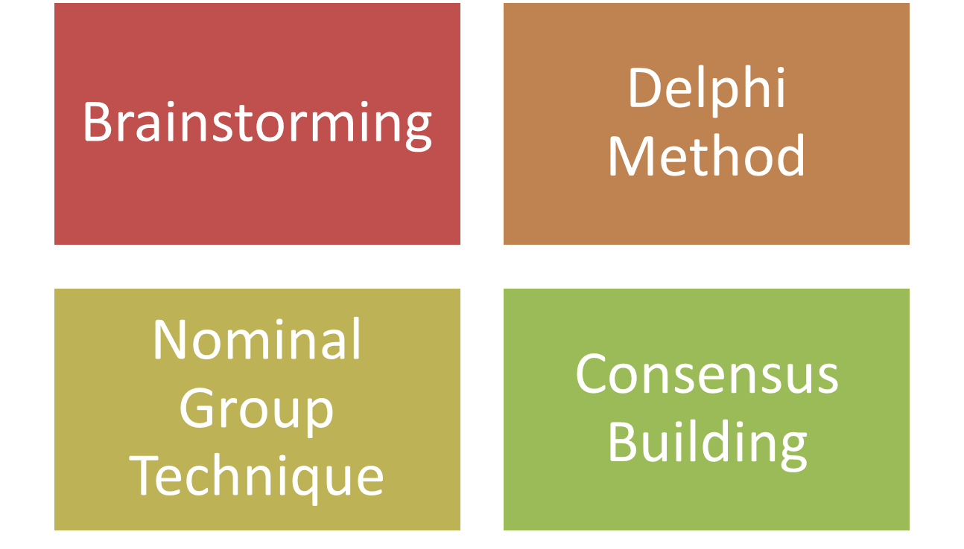
Forms of Group Decision-Making

Slide 7




























Forms of Group Decision-Making
Form | Description
Brainstorming | Generating many ideas without criticism
Delphi Method | Anonymous experts give opinions iteratively
Nominal Group | Structured meeting to rank ideas
Consensus | General agreement among all members

Slide 8
Employee attrition
Employee leaving jobs – attrition
HR head calls a meeting of 5 leads
- wfh – hybrid – some Sodexo voucers

Slide 9
What are Quantitative Techniques?
Use mathematics and statistics to support decision-making.
Provide objective, data-driven support to managers.
Mathematical Models = Equations or optimization problems
Statistical Models = Probability-based analysis of outcomes
Data driven decision making DDDM

Slide 10
Model 1: Linear Programming (LP)
Application: Resource Allocation
Formula:
- Maximize Z = 5A + 4B
Subject to:
2A + B <= 100
3A + 2B <= 120
A, B >= 0

Slide 11
Model 2: Decision Trees
Application: Sequential investment or product launch decisions.
Key Components:
- Decision nodes
- Chance nodes
- Probabilities and payoffs
Example:
Should a customer get loan based on his credit score and demographic details?

Slide 12

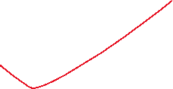
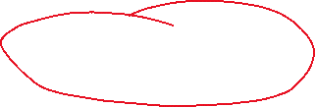
Sample Decision Trees
CIBIL SCORE > 650
Yes
No
Is currently employed?
Loan not given
Yes
No
Loan given
Loan not given

Slide 13
Model 3: Regression Analysis
Application: Predict sales/revenue/ costs/ stock price / IPO listing gains
Formula: y = mx + c equation of a straight line
Y = a + bX
Where:
Y = Dependent variable (e.g., Sales)
X = Independent variable (e.g., Advertising Spend) X2: number of sales people
Simple linear relationship between X and Y

Slide 14
MCQ
What distinguishes multiple linear regression from simple linear regression?
a) The number of dependent variables
b) The number of independent variables
c) The use of a different least square formula
2. In a multiple linear regression model, if you have ‘p’ predictors, what is ‘p’?
a) The number of coefficients
b) The number of intercepts
c) The number of residuals
d) The number of independent variables

Slide 15
MCQ
What distinguishes multiple linear regression from simple linear regression?
a) The number of dependent variables = Y
b) The number of independent variables
c) The use of a different least square formula
Answer: b) The number of independent variables
2. In a multiple linear regression model, if you have ‘p’ predictors, what is ‘p’?
a) The number of coefficients
b) The number of intercepts
c) The number of residuals
d) Answer: d) The number of independent variables.
The number of independent variables

Slide 16
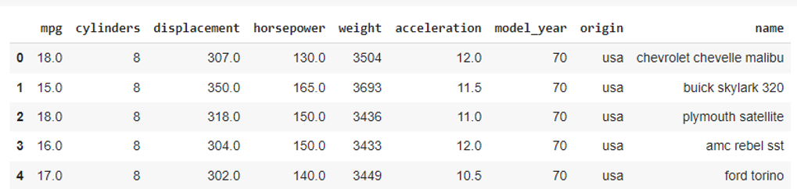



Example: Consider the snapshot of the first five rows of mpg dataset below, where the target variable is mpg and we have 8 predictors, or “p”.

Slide 17
Forecasting & Estimation in Business Decision-Making

Slide 18
What is Forecasting & Estimation?
Predict future events
Essential for planning, budgeting, strategy

Slide 19


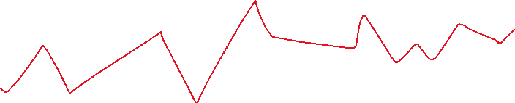










Technique 1: Time Series Analysis
Application: Sales and stock price forecasting
Components:
Trend,
Seasonality,
Cycles,
Randomness
Example: Forecast next month's sales based on past 12 months' data.

Slide 20
Technique 2: Moving Average Method
Application: Smooth out short-term fluctuations
Formula: SMA = (Sum of last n values) / n
Example:
Average sales over last 3 months to predict next month.

Slide 21
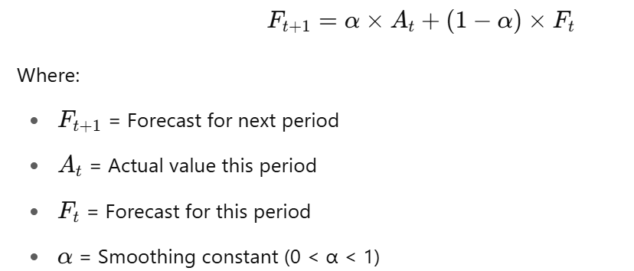






Technique 3: Exponential Smoothing
Application: Weight recent data more. This means predict next period's value by giving more weight to recent data.
Formula:

Slide 22
Applications in Business and Finance
Financial Markets:
  Forecast stock prices (Time Series, Regression)
  Risk assessment (Decision Trees)
Business Planning:
  Optimize production (Linear Programming)
  Budgeting and sales forecasting (Moving Averages, Exponential Smoothing)
Operations:
  Budgeting,
  Production planning

Slide 23
MCQ
Q1: What is the main drawback of group decision-making?
A) Speed
B) Cost
C) Groupism
D) Independence
Q2: Linear Programming is primarily used for:
A) Predicting sales
B) Resource optimization
C) Customer segmentation
D) Brainstorming

Slide 24
MCQ
Q1: What is the main drawback of group decision-making?
A) Speed
B) Cost
C) Groupism ✅
D) Independence
Q2: Linear Programming is primarily used for:
A) Predicting sales
B) Resource optimization ✅
C) Customer segmentation
D) Brainstorming

Slide 25
MCQ
Q3: Exponential smoothing is a method of:
A) Estimation
B) Cost reduction
C) Optimization
D) Data mining
Exercise:
Given sales data for last 3 months: ₹1000, ₹1200, ₹1100. Find 3-month moving average.

Slide 26
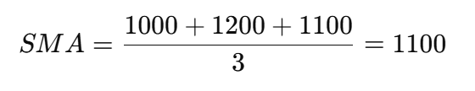
MCQ
Q3: Exponential smoothing is a method of:
A) Estimation ✅
B) Cost reduction
C) Optimization
D) Data mining
Exercise:
Given sales data for last 3 months: ₹1000, ₹1200, ₹1100. Find 3-month moving average.

Slide 27
Session Summary
In this session, we have discussed about:
Understand group decision-making
Apply quantitative and statistical models
Learn forecasting techniques

Slide 28
References
How to Formulate a Linear Programming Problem — the Davengers way
- How the Davengers Solved a Linear Programming Problem using Python
https://medium.com/@vikashsinghy2k/complete-guide-to-decision-tree-classification-in-python-with-code-examples-6f69f408f880
https://medium.com/@vikashsinghy2k/beginners-guide-to-linear-regression-in-python-0fce3b1d1bf0

Slide 29

Happy Learning

